Slide 1

How Cities Can Help Neighborhood Businesses Survive and Thrive in Phases 1.5 and 2
June 15, 2020

Slide 2
Agenda
10:30 Welcome and Introduction Deanna Dawson
10:35 Background on Phases 1.5 and 2 Pam Cant
10:40 Responding to Phase 1.5 and 2 Reopening Guidelines Sarah Pyle
10:50 Creative Ideas to Help Businesses Succeed Andrea Reay
11:00 Sharing Ideas from Cities All
11:15 Q and A All
Notes:
Let us know what we can do to provide value to you!

Slide 3
Panelists
Pam Cant, Department of Labor and Industries
Pam Cant is a Consultation Operations Manager with the Department of Labor and Industries, Division of Occupational Safety and Health.
Sarah Pyle, Redmond Strategic Initiatives Manager
Sarah Pyle is a community and economic development professional with the City of Redmond. She is currently assigned as the City’s Recovery Manager for the COVID-19 pandemic; in addition, she manages the economic development, tourism, and land use development divisions. She is known for developing innovative ways to streamline processes, reducing the cost of doing business and leveraging technology options already available for use of economic development. Most recently the City has developed What’s Open Eastside, a free marketing tool for all businesses. Prior to joining Redmond in 2015 Sarah worked with other cities on the Eastside and ran a small business. She believes collaboration and asking questions can bring even the most complex across the finish line. Change the World from Redmond
Andrea Reay, Seattle Southside Chamber CEO
Andrea H. Reay is a native of the Pacific Northwest and is an experienced non-profit manager, business consultant and community organizer. Andrea worked for over 15 years in non-profit arts management. In 2013 she expanded her non-profit experience to work at Discover Burien, a non-profit organization focused on marketing and promoting the City of Burien. In 2016 Andrea accepted the position to serve as the President/CEO at Seattle Southside Chamber of Commerce. She is thrilled to be able to maximize her varied experience growing up in a family that knew the challenges of owning a small business as well as non-profit management to be able to maximize the services and benefits the Chamber is able to provide and deliver for the community of Southwest King County.
Notes:
Let us know what we can do to provide value to you!

Slide 4
Phase 1.5 or “Modified Phase 1”:

Slide 5
Protecting the Safety and Health of Workers
Coronavirus Disease (COVID-19)
Pam Cant
DOSH Consultation Operations Manager
www.lni.wa.gov/coronavirus

Slide 6
Employers Written Safety Plan for COVID-19
Educate workers in the language they understand best about coronavirus and how to prevent transmission and the employer’s COVID-19 policies.
Maintain minimum six-foot separation between all employees and customers.
Provide personal protective equipment (PPE) such as gloves, goggles, face shields and face masks as appropriate or required to employees for the activity being performed.

Slide 7
Ensure frequent and adequate hand washing with adequate maintenance of supplies.
Establish a housekeeping schedule that includes frequent cleaning and sanitizing with a particular emphasis on commonly touched surfaces.
Screen employees for signs/symptoms of COVID-19 at start of shift.
Have a site-specific COVID-19 Supervisor designated by the employer at each job site to monitor the health of employees and enforce the COVID-19 job site safety plan.

Slide 8
DOSH Consultation Program
Who we are.
Services we can provide to the employer.

Slide 9
DOSH Directives
  DOSH Directive 11.80 Respirators and Face Covering
  https://lni.wa.gov/dA/1d2a778d31/dd1180.pdf
  DOSH Directive 1.70 General Coronavirus Prevention
  https://lni.wa.gov/dA/36e85758be/DD170.pdf
www.lni.wa.gov/coronavirus

Slide 10
Additional Resources
Information on Paid sick leave, Workers Compensation, or Workplace Safety & Health
https://www.lni.wa.gov/agency/outreach/novel-coronavirus-outbreak-covid-19-resources
Request free a consultation
https://lni.wa.gov/safety-health/preventing-injuries-illnesses/request-consultation/
Notes:
The WA Dept. of Health is the lead agency for the State on Pandemics.
L&I DOSH (WA-OSHA) is the lead work place safety and health and worker’s compensation agency for the State of WA.
These links provide questions and answers, prevention measures, and educational materials to help workers and employers understand what to do in the event of a pandemic. Please also visit the CDC and OSHA to keep up to date with the latest information.

Slide 11
Contact Information
Pam Cant
DOSH Consultation Operation Manager
360-902-5735
edwp235@lni.wa.gov
DOSH Web Page: https://lni.wa.gov/safety-health/
Notes:
The WA Dept. of Health is the lead agency for the State on Pandemics.
L&I DOSH (WA-OSHA) is the lead work place safety and health and worker’s compensation agency for the State of WA.
These links provide questions and answers, prevention measures, and educational materials to help workers and employers understand what to do in the event of a pandemic. Please also visit the CDC and OSHA to keep up to date with the latest information.

Slide 12

Responding to Phase 1.5 and 2 Reopening Guidelines

Slide 13
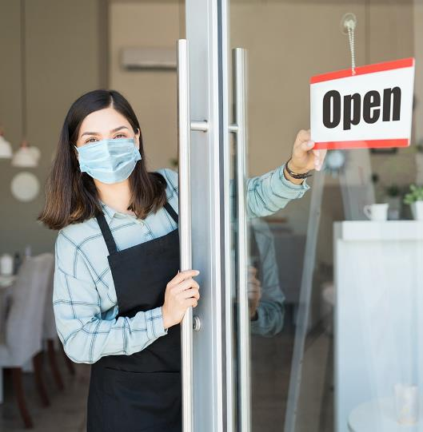
Barriers to Reopening
PPE
Space to serve customers
Staffing
Digitizing operations
Advertising

Slide 14

Curbside Pick-up
Signage
  Provide to businesses directly
  Provide printable file
A-Frames
  Waive permits
  Waive restrictions
Re-deploy parking enforcement

Slide 15
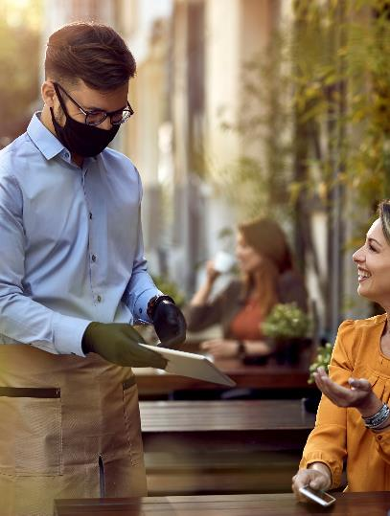
Café Seating
Eateries
  Coffee shops
  Bars
  Full service restaurants
Non-eateries
  Tax offices
  Personal and Health Care
  Veterinarians
ADA compliance
  clear zone must be maintained
Permitting
  ROW/ Temporary Use
Alcohol
  Must meet LCB requirements

Slide 16
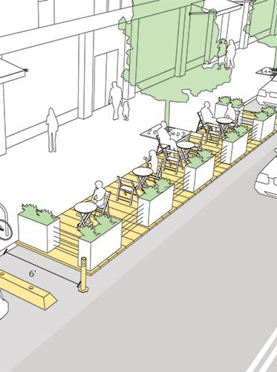
Repurposing of Parking
Private
  Adjacent to businesses
  Non-adjacent
Public
  On-Street
Impacts/Conditions
  Walkshed
  Safety
  Maintence

Slide 17
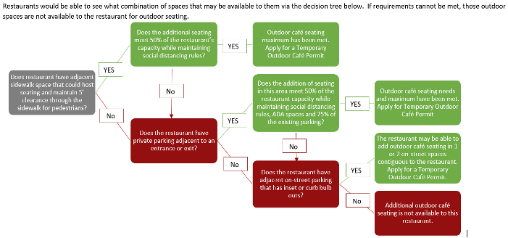
Decision Tree

Slide 18
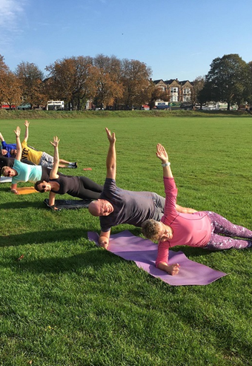
Parks and Open Spaces
Two Approaches:
  Contractor Agreements
  Multi-scope RFPs
Considerations at a high-level:
  aligned with park goals and fitting for the location
  Cannot increase operational costs of the park
  Must accommodate other parks activities
  Must be located per area identified by staff
  No Alcohol is permitted in any parks
  It doesn’t duplicate with what the city is already offering.
  It safe, healthy, and adds a benefit.
  Remuneration, to satisfy the RCW’s of not gifting public land.
Notes:
Examples of businesses:
Fitness
Small kids’ camps
Music lessons
Art instruction
Photography
Coffee stand and bistro tables

Slide 19
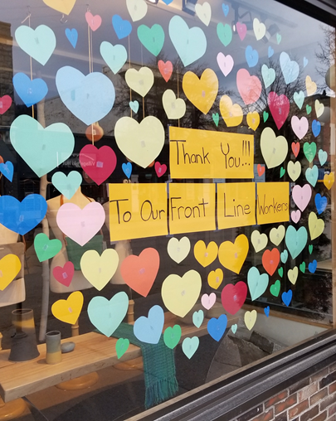
Community Led Initiatives
Examples of Community led Initiatives:
  Drive-in eating and dining experiences
  Food runners
  Painting business windows with messages of encouragement, appreciation and art
  Sewing masks or creating PPE
  Art walks
  Live music
  Food drive
  Promote on social media
Grants for businesses:
  Transportation Demand Management Grants
  CARES Act

Slide 20
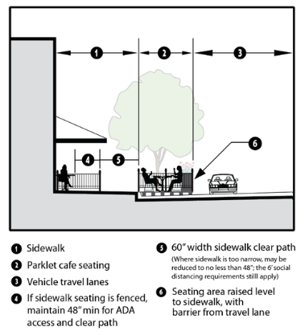
Policy and Permit Considerations
Temporary use permits
Right-of –way permits/restrictions
Equity
Long-term Impacts
Fees Reductions
Streamlining and creating OTC process
Governor's Orders

Slide 21
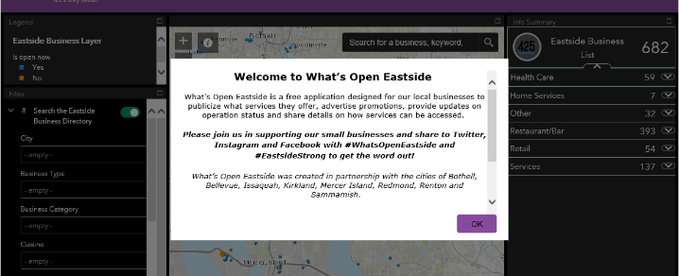
Additional Small Business Resources
What’s Open Eastside
  Free interactive marketing tool for businesses to share about their current operations models, hours and other information.
  Can be updated in real-time by business operators
Eastside Recovery Hub
  Offering 1:1 assistance in:
    Renegotiating leases
    Creating HR and other reopening policies
    Loan packaging
    Webinars in multiple languages
    Template forms
    Updating and pivoting business models
(re)StartUp425
  Offering 1:1 financial assistance including full loan packaging

Slide 22
City of Redmond
Sarah Pyle
Recovery Manager
425-556-2426
spyle@redmond.gov
Notes:
Closing Slide

Slide 23

The Southside Mitigation And Recovery Taskforce (SMART) is a public/private taskforce that strives to find real solutions to the challenges our community faces as we confront the human and economic impacts of COVID-19.

Slide 24

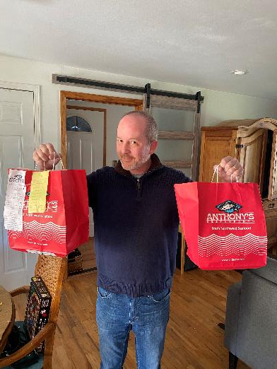
Communication, Cooperation and Creative Solution Finding.
City of Des Moines- EATS (Emergency Assistance to Seniors and Vets) Program
Providing gift cards to local restaurants to seniors and vets
Webinar Series and Virtual Events
Notes:
EATS program (Emergency Assistance to Seniors and Vets) and the restaurants that are participating. We appreciate the flexibility of King County in the use of the Senior and Vets levy funds for this program

Slide 25
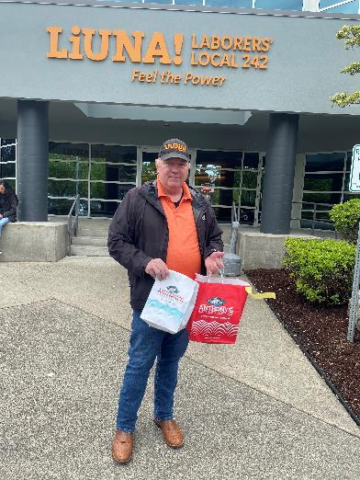
Webinar Series and Virtual Events

Slide 26
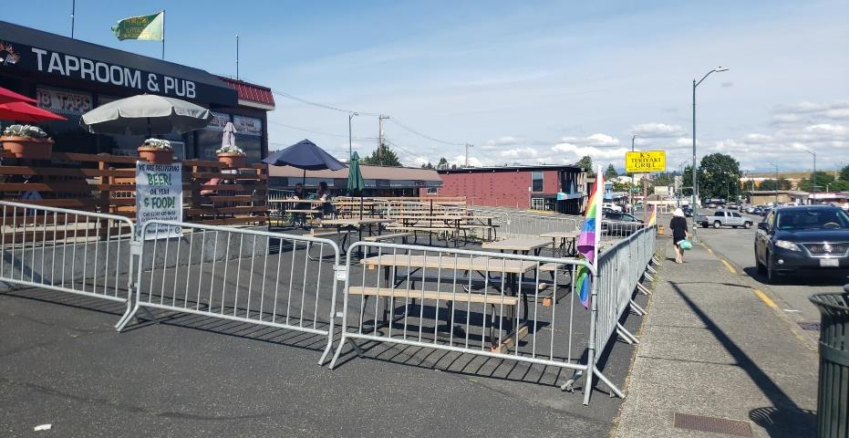

Webinar Series and Virtual Events
Notes:
When modified Phase 1 started, our businesses were ready! This restaurant in Burien was able to more than double their seating capacity because the City of Burien waived permit fees for ROW permits and allowed temporary use permits for outdoor seating for private parking.

Slide 27
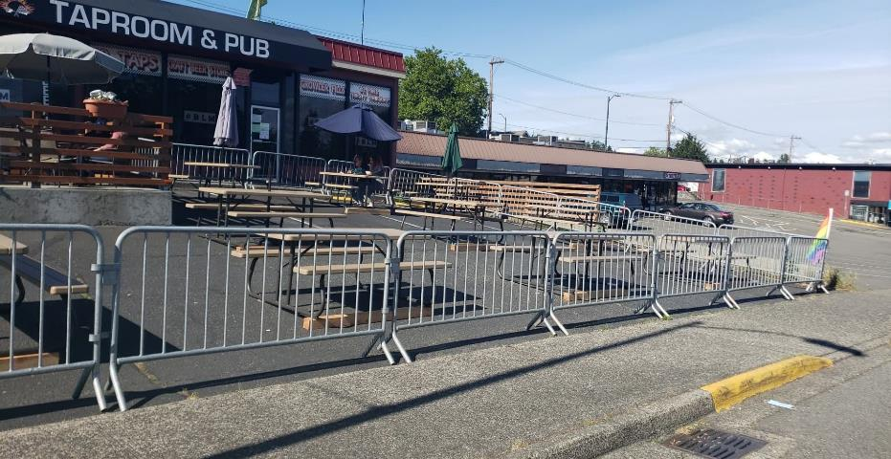
Webinar Series and Virtual Events
Notes:
20 people inside-35 outside-total of 55 people, continue with carry out and delivery as well and now doing more than average daily revenue

Slide 28
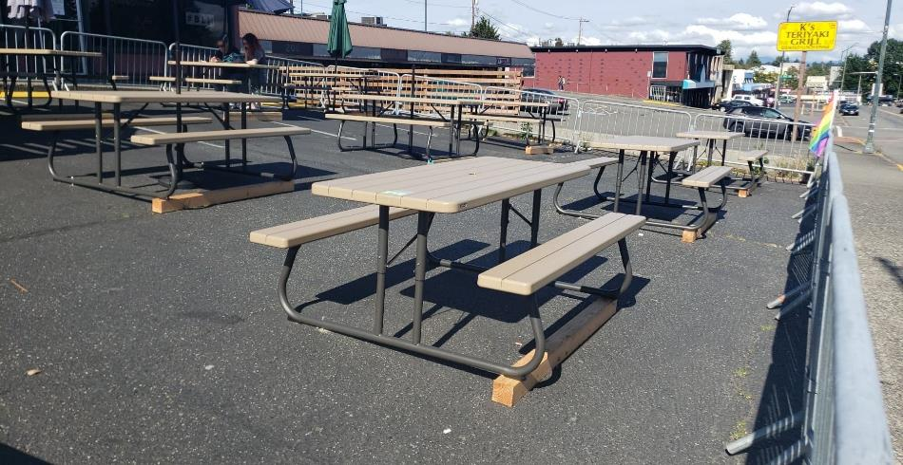
Technical Assistance

Slide 29
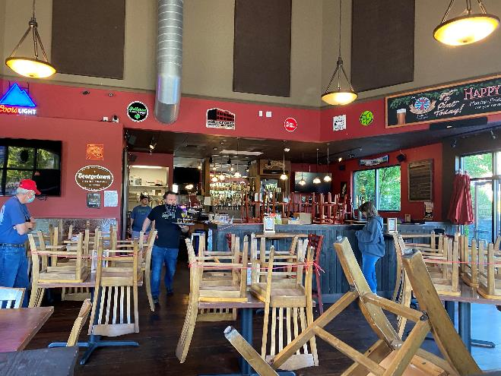
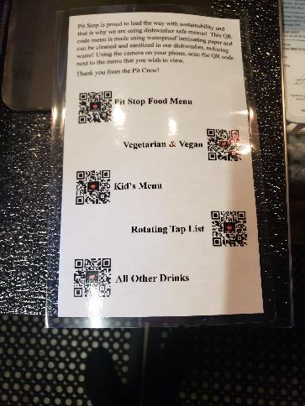
Technical Assistance
Notes:
Every restaurant is unique and layouts offer challenges

Slide 30
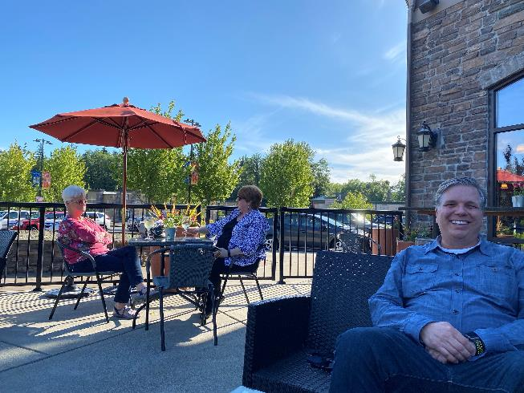
Technical Assistance

Slide 31
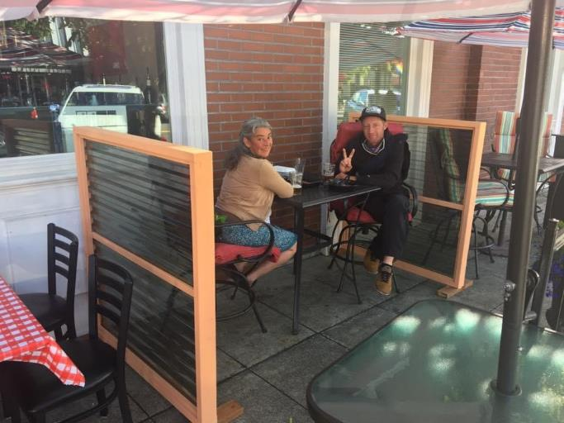
Technical Assistance

Slide 32
Communication and Creative Support
Community Development, Planning and Public Works Streamlining Permit Process
Waiving Fees when possible
Temporary Use Permit for Private Parking and ROW
Defer B & O Tax
Sign Code Updates-A-Frames
Notes:
Tukwila-redirecting Parks staff to do Business Outreach, Burien deferring B and O tax, SeaTac Normandy park prioritizing outreach, Des Moines direct support with EATS

Slide 33
Additional Resources
SCA Cities:
Bellevue – Business resources incl. curbside pickup zones, B&O tax deferral, street use permit
Bothell – Allowing temporary change of use from parking to outdoor seating
Burien – Business resources, B&O tax deferral
Des Moines – EATS program
Enumclaw – Outdoor dining, closing streets, renting equipment; www.supportenumclaw.com
Issaquah – Business Resources; COVID meal allowance program; B&O Tax Deferral
Tukwila – Surveying businesses, sign code changes, etc.
Startup 425 – Business resources, What’s Open Eastside
Other cities:
Everett – Safe Reopening Toolkit
Spokane – Restaurant and Retail Expansion Program
Leavenworth – Front Street Closure

Slide 34

Other Programs/Resources to Share?

Slide 35

Questions?

